Slide 1
Week 03

Slide 2


Natural Language Processing
Understanding
Generating
.
.
.
.
.

Slide 3
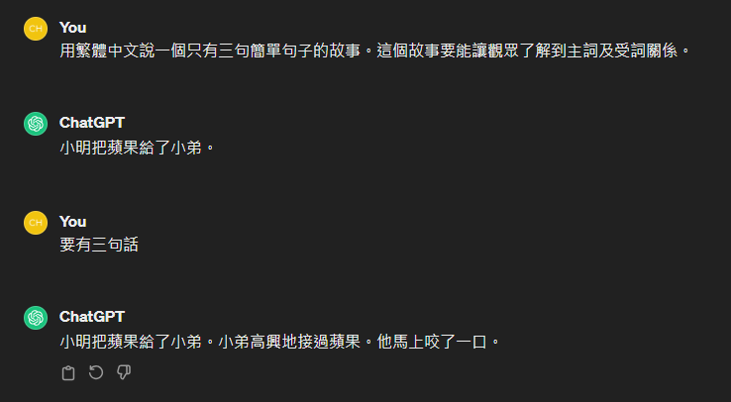
Natural Language Understanding

Slide 4
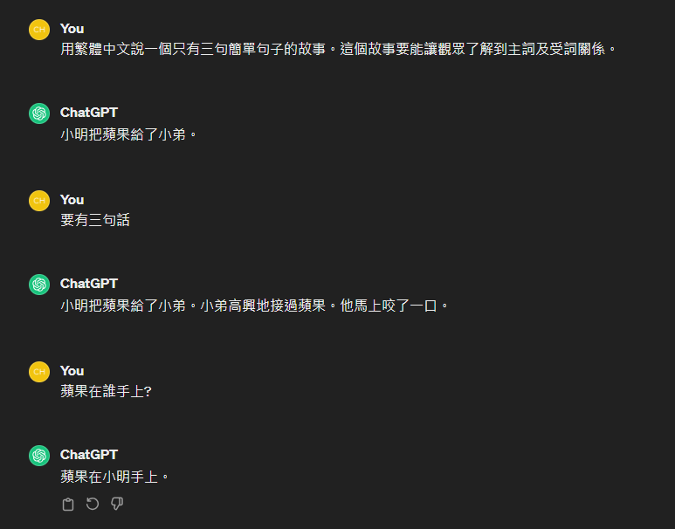

Slide 5
小明把蘋果給了小弟

Slide 6
小明把蘋果給了小弟

Slide 7



小明把蘋果給了小弟
小明(n)把蘋果(n)給了小弟(n)

Slide 8
小明把蘋果給(v)了小弟
____把____給(v)了____

Slide 9
小明把蘋果給了小弟
小明(n)把蘋果(n)給了小弟(n)
小明把蘋果給(v)了小弟

Slide 10
小明把蘋果給了小弟
小明(n)把蘋果(n)給了小弟(n)
小明把蘋果給(v)了小弟
HOW ?

Slide 11
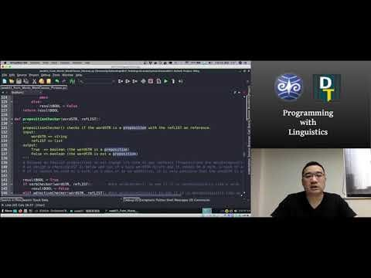
Source:https://github.com/Droidtown/NLP_TrainingLab/tree/main/Syntax101/week01

Slide 12
Hands-On
3 People/ Team
1 Function/People
Collaborate using Github

Slide 13
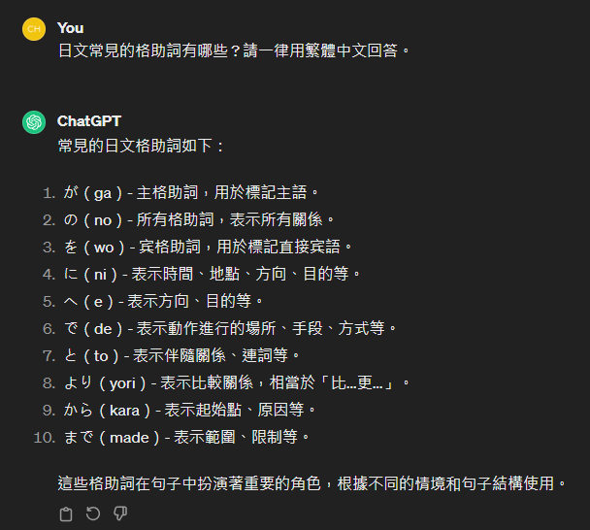

Slide 14
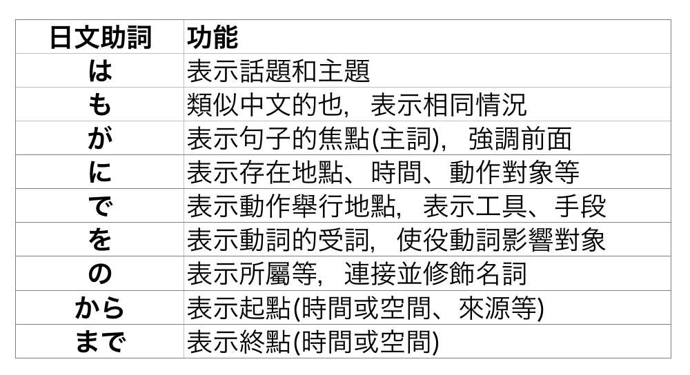

Slide 15
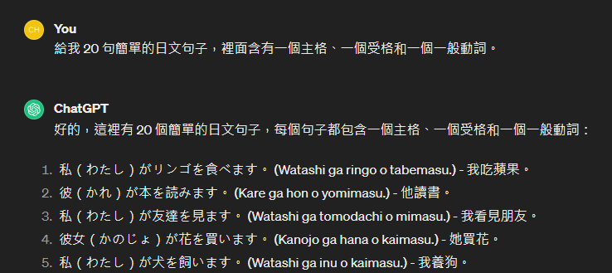

Slide 16
Spec
Collab using GitHub (One Repo)
Share the link with Jonathan.
inputSTR.txt (20 sentences)
Test using caseparse(inputLIST)
For freshman :
Lab Hour Tues 14:30~16:30 by appointment

Slide 17
inputSTR = “私はラーメンを食べます”
resultDICT = {
“Subject”:”私”,
“Object”:”ラーメン”,
“Verb”:”食べ”
}
def caseparse(inputLIST):
extractSubject(inputLIST)
extractObject(inputLIST)
extractVerb (inputLIST)

Slide 18
Hint
inputSTR = “私はラーメンを食べます”
https://chat.openai.com/
https://medium.com/ccclub/ccclub-python-for-beginners-tutorial-d26900b9280e

Slide 19
Sprint
14:50~15:40 Sprint
15:40~16:00 Share (Progress/Problem)

